Slide 1
Never judge a book by its cover?
by Dániel Kelemen

Slide 2


Dataset
Goodreads-books from Kaggle
11127 unique books
Notable features:
Title
Author
Rating averagre
Number of pages
Number of ratings
Number of reviews

Slide 3
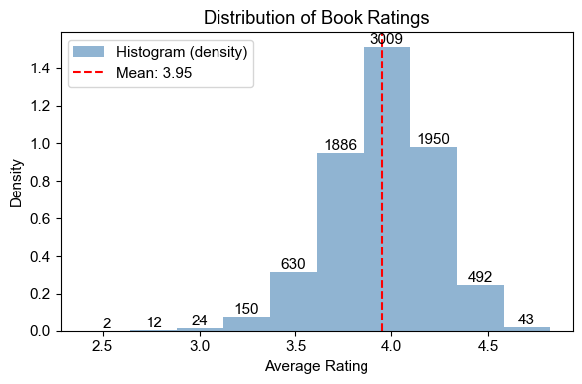
Dataset engineering
Filters
Invalid titles and ratings
Non-english
< 100 ratings
8198 unique books remaining
TF-IDF vectorization on titles
5000 unique values

Slide 4
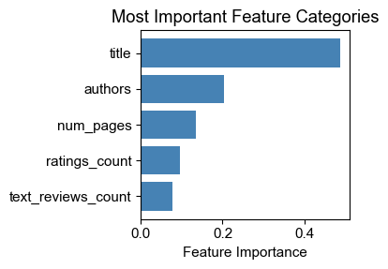
Model
Random forest regression
Training-test data split
80% training
20% test
Vectorised title ~50% importance

Slide 5
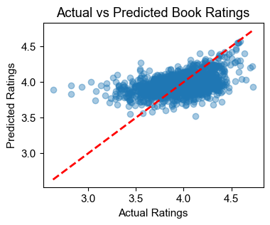
Results
R² score: 0.211
RMSE score: 0.233
11% improvement
MSE score: 0.054
21% improvement

Slide 6
Maybe judge (a little)
Thank you

